Slide 1

SPARK FOUNDATION INTERNSHIP Task3
Data Analyst
Ameen Abdulbaru

Slide 2

About Data
SUPERSTORE RETAILS
Explanatory Data Analysis Report
The Super store retail dataset is a typical data store details consisting of goods sold in various category. The data is involved with 11 variables represented.
-Ship mode, Segment, City, State, Postal code, Region, Category, Subcategory, Sales, Quantity, Discount, Profit.
Ship mode- The shipping method used in the store
Segment- The sections of the stores
This Photo by Unknown Author is licensed under CC BY-SA-NC

Slide 3

OBJECTIVE
1
As a business manager, try to find out the weak areas where you can work to make more profit.
2
Create dashboards or story board and screen-record along with your audio explaining the charts and interpretations
This Photo by Unknown Author is licensed under CC BY-SA

Slide 4
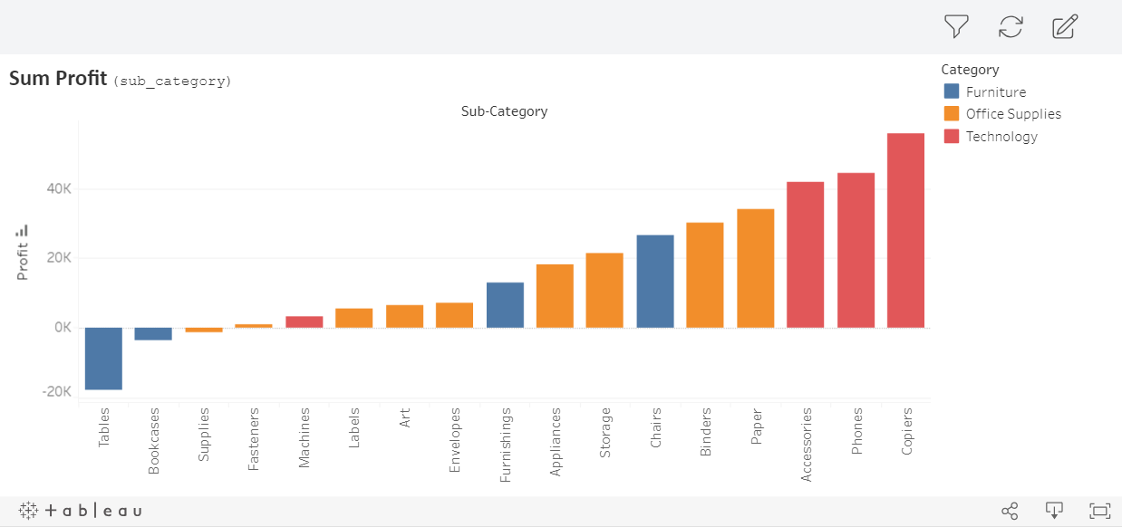
Retail store overview
The interactive visualization below indicates the total profit earned by the store representing the sub categories of items with respective “Category” indicated below.
The visualization shows 3 items with no profit earned i.e.(Tables, Bookcases and Supplies) with a profit of( -17725, - 3473 & - 1189).

Slide 5
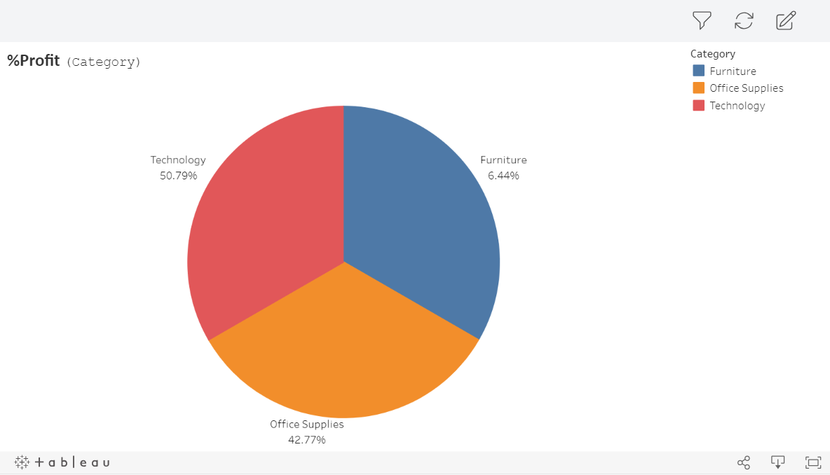
overview
The analysis below shows the percentage profit of product category. The data indicates that “Furniture products” earns the least profit compared to the rest. Irrespective, it also shows a proper sale percentage from the categories represented.

Slide 6
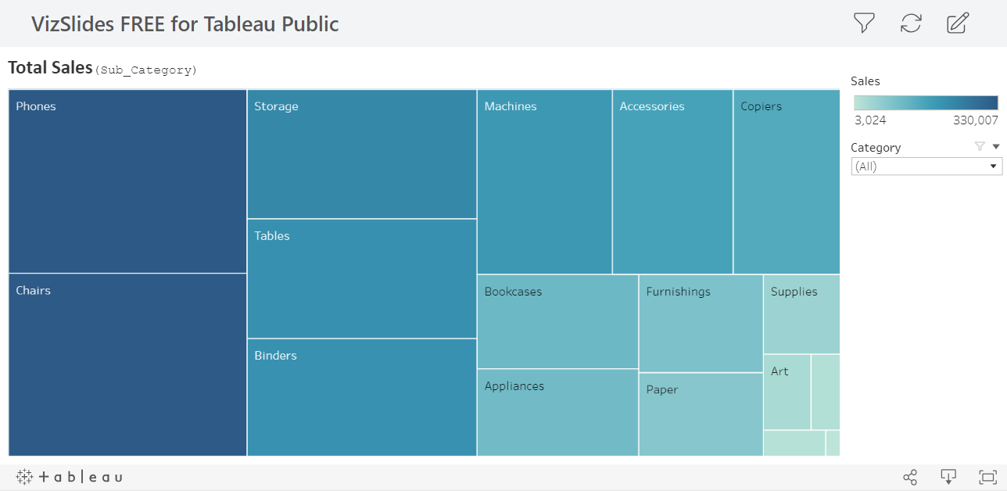
overview
Here is a heat map indicating the total sales of product sold. The heat map shows a color gradient of how the sales of each product is sold. The visualization indicates (Envelope, Art and Fasteners) are the least product sold compared to the rest.

Slide 7
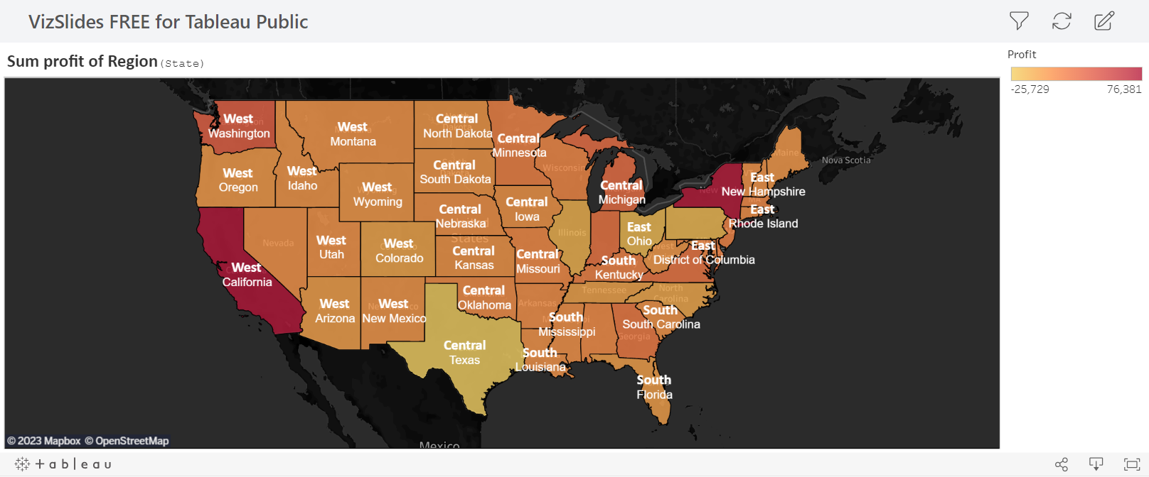
overview
Since the data is originally gotten from the United State, a representation of the Total profit earned from each state along with its region is shown below. A color gradient is used in showing the sum of profits. The lower the color the less profit is earned also vice versa.

Slide 8
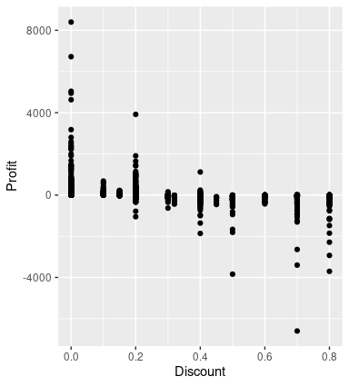
overview
In other to understand the data more, analysis was done using R program with the intention of observing the relationship between Profit and Discount. From the analysis, it was shown that discount above 0.3 lowers the profit earned significantly.

Slide 9
Funding
Total Sales
$ 2297200.85584933
Total Profit
$ 286817.020810917
No of Quantity
37873

Slide 10

Problems
Market gap
The southern region of the country is experiencing lower profit than the rest.
Financials
Appropriate sales were gotten from some products but still exhibited minus profits (Tables, Bookcases and Supplies).
The more discount added to a product lowers the profit.
Products
Furniture category had the lowest rate of profit.

Slide 11

Summary &Conclusion
SPARK FOUNDATION
In conclusion, cutting the discount will increase the profit of the 3 products(tables, bookcases and supplies)i.e. profit margin are higher when selling the products at full price, compared to selling at a discount. Additionally, the profit margin lost through discounting will still have to be made up with future opportunities so you will have to sell more to get back revenue lost.

Slide 12

Thank you
Ameen Abdulbaru​
+234 8155073813
abdulbarrameen@gmail.com
Ameen Abdulbaru | LinkedIn

